Slide 1
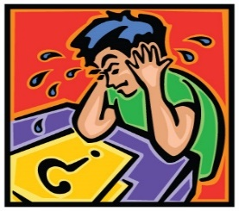
MCAS 2.0

Slide 2

Shedding Some
Light on
MCAS
2.0

Slide 3
WHY Common Core
Standards and TEST?
Jeb Bush:
“Born Poor, Stay Poor”

Slide 4
Standards and Assessment of Learning:
Can Needier Students Learn?

Slide 5
MCAS 2.0
ASSESSES
STANDARDS LEARNING

Slide 6
Classroom Practice
The Tests
Ensure
Standards Learning

Slide 7
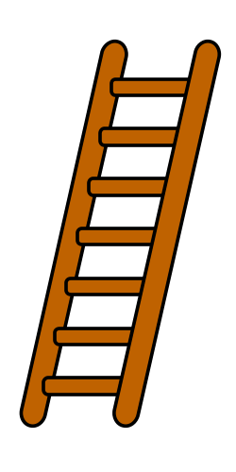
MA ELA Standards
Build
from Year to Year

Slide 8


Slide 9
Classroom Practice
Assess student learning,
Teach the Standards Needed
For good test results

Slide 10
Test Features
MCAS 2.0
Test
Features

Slide 11
Test Features
MCAS 2.0
is about
EVIDENCE

Slide 12

Test Features
Where’s the
EVIDENCE

Slide 13
Test Features
MCAS 2.0
Is Part A,
Part B:Evidence

Slide 14



CLASSROOM PRACTICE
Where is the
EVIDENCE?

Slide 15
Test Features
Test Strategy:
Select best
Example from
Part B

Slide 16
Classroom Practice
Teach students to
Go Back to
The Paragraph

Slide 17
Classroom Practice
Teach students to go back to the paragraph
Use “Baby Steps”

Slide 18
Classroom Practice
Teach Students to Go Back to **The Paragraph**
Use “Baby Steps” and
Ask to Apply this on the test

Slide 19
Classroom Practice
Vygotsky’s
“Zone of
Proximal Development”

Slide 20
CLASSROOM PRACTICE
We learn at
the Next Best Step Up
for Us

Slide 21
We learn at the next best step up for us
Can’t read at Too
Hard text

Slide 22
We learn at the next best step up for us
But Interest level overrides skill level

Slide 23
Test Features
MCAS 2.0
Focuses on
2011 MA ELA Standards

Slide 24
Test Features
MCAS 2.0:
Finer Reading
Ability

Slide 25
Test Features
MCAS 2.0
More Complex Reading Passages

Slide 26
Test Features
Test skills are:
Close reading
Central Idea
Inference

Slide 27
Test Features
Test skills are:
Reading
Comprehension,
AND Literary Analysis

Slide 28
Classroom Practice
MA Standards and MCAS 2.0
Idea development in writing
Not formulaic writing

Slide 29
Test Features
MCAS 2.0
Varied Types of Writing,
Purpose & Audience

Slide 30
Test Features
“Write a Narrative”
Means gr level
Standard Facets

Slide 31
Standards Features
Reading and
Writing Standards are Connected:
Read Argument,
Write Argument

Slide 32
CLASSROOM PRACTICE
Read for Central Idea,
Write: Make a case for
Central Idea
& Supporting Details

Slide 33
CLASSROOM PRACTICE
Build Reading and Writing
Classroom practice:
Read, Discuss,
then Write

Slide 34
CLASSROOM PRACTICE
Know your
grade level
Standards
Well

Slide 35
CLASSROOM PRACTICE
Be an
Opportunist:
Seize the Opportunity
To Teach a Standard

Slide 36
Classroom Teaching
Constructivist Teaching:
Connect with where Students are
Seize the moment!

Slide 37
CLASSROOM PRACTICE
Differentiate
as Needed

Slide 38
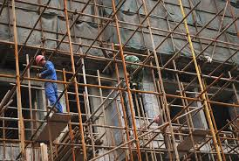
CLASSROOM PRACTICE
SCAFFOLD AS NEEDED

Slide 39
CLASSROOM PRACTICE
Name
the
Standard

Slide 40
CLASSROOM PRACTICE
Use TERMS: Central Idea,
Supporting Details,
Inference,
Context Clues
“Sources”

Slide 41
CLASSROOM PRACTICE
But . . . It’s OK to use
“Hook,”
“Clincher”
“Connecting Words”

Slide 42
But . . . It’s OK to use
“Hook,”
“Clincher”
“Connecting Words”

Slide 43
CLASSROOM PRACTICE
Strategy:
Use
Mini-lessons,
“Focus Lessons”

Slide 44
CLASSROOM PRACTICE
Teach mini-lessons as needed:
“Supporting Details,”
“Paraphrasing”
for Research

Slide 45
CLASSROOM PRACTICE
Learning Development:
Connect with Student’s life
Details for “Probably True”
Frequent Varied Writing

Slide 46
CLASSROOM PRACTICE
MCAS 2.0 Prep
is
Learning Development

Slide 47
CLASSROOM PRACTICE
MCAS 2.0 Prep
is
Teaching for Understanding,
Skills

Slide 48
CLASSROOM PRACTICE
MCAS 2.0 Prep
is
Practice Tests
in March

Slide 49
CLASSROOM PRACTICE
MCAS 2.0 Prep
is Practice Tests,
Assess,
Re-Teach in New Way

Slide 50
CLASSROOM PRACTICE
Smother students
with Reading
Opportunities

Slide 51


Slide 52
A Multitude of Readings

Slide 53

CLASSROOM PRACTICE Independent Reading
Classroom Libraries

Slide 54

MORE READING VIA
TECHNOLOGY

Slide 55
CLASSROOM PRACTICE
Reading Independently
Develops
Comprehension,
Vocabulary, Fluency

Slide 56
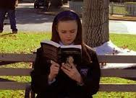
CLASSROOM PRACTICE
Independent Reading
Creates
Strong
Readers

Slide 57
Classroom Practice
Supplement with varied types of reading
Fantasy books, Boy books,
Sports books
Biographies, Science Fiction
Walter Dean Meyers: Hoops
Classics: Wuthering Heights

Slide 58
Classroom Practice
READ, Read, read
AND Write about it (simple)
As Comprehension check
Reading, writing

Slide 59
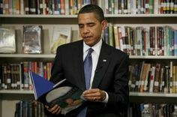
CLASSROOM PRACTICE

Slide 60

WRITING
STANDARDS

Slide 61
Classroom Practice
MA State Standards Writing
Moves from formulaic writing to
Idea development in writing

Slide 62
Classroom Practice
Writing is Thinking:
“90/90/90” Study

Slide 63
CLASSROOM PRACTICE
Writing:
Use the Writing Process
Drafting, Peer Edit,
Conferencing, Revision

Slide 64
LucyCalkins Writing Program
Focus is
Student
Self-Assessment (6-8)

Slide 65
Common Practices
used across grades with varied subjects and over the grades, from 6th to 7th grade Reinforce Learning

Slide 66
Common Practices:
The Writing Process
Peer Editing
Student Research

Slide 67
Common Practices:
Reading skills:
with Informational Text: Close reading, Central Idea & Details,
Context Clues for Vocabulary

Slide 68
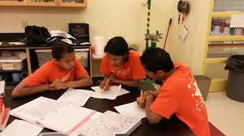
CLASSROOM PRACTICE PEER EDITING

Slide 69
CLASSROOM PRACTICE
Peer Editing
Provides student
Metacognition
Learning about Learning

Slide 70
CLASSROOM PRACTICE
Peer Editing:
Structure Peer Editing
Calculated Partners
Baby Steps Practice

Slide 71
CLASSROOM PRACTICE
Peer Editing
Scaffold:
A Bank of Comments
or Two Comments

Slide 72
CLASSROOM PRACTICE
Peer Editing:
Students Learn
When they are
Actively Engaged

Slide 73
CLASSROOM PRACTICE
Peer Editing:
Teacher Individual
Conferencing, and
Students benefit as editors, reviewers

Slide 74
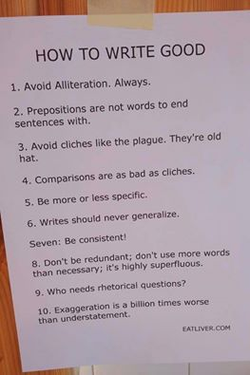

Slide 75
CLASSROOM PRACTICE
Big Questions:
How to Turn Learning
Over to the
Students?

Slide 76
CLASSROOM PRACTICE
Big Questions:
How to teach for challenging reading passages?

Slide 77
MCAS 2.0
Test is April
Test designs and other resources
posted by DESE soon
MCAS 2.0 test posted January
Meanwhile, parcc.pearson.com

Slide 78
Great Standards Teaching
Results in Great Learning

Slide 79


