Slide 1

MCAS 2.0

Slide 2

Shedding Some
Light on
MCAS
2.0

Slide 3
MCAS 2.0
ASSESSES
STANDARDS LEARNING

Slide 4
K – 2 Focus:
Phonemic Awareness
Phonics, Reading for Meaning

Slide 5
K – 2 Focus:
Help each child develop Basic
Reading Comprehension

Slide 6
Grade 3 Focus:
Help each child develop Reading Comprehension, then move to Standards

Slide 7
Test Features
MCAS 2.0
Assesses Learning on
2011 Standards

Slide 8
Test Features
MCAS 2.0
Test
Features

Slide 9
Test Features
MCAS 2.0
Is about
EVIDENCE

Slide 10

Test Features
Where’s the
EVIDENCE

Slide 11
Test Features
MCAS 2.0
Is Part A,
Part B: Evidence

Slide 12



CLASSROOM PRACTICE
Where is the
EVIDENCE?

Slide 13
Test Features
Test Strategy:
Select best
Example from
Part B

Slide 14
Test Features
MCAS 2.0
Finer Reading
Ability

Slide 15
Test
Features
MCAS 2.0:
More Complex Reading Passages

Slide 16
Test Features
Test skills are:
Close reading
Inference
Central Idea
Vocabulary Clues
Varied Writing

Slide 17
Test Features
MCAS 2.0
Varied Types of Writing

Slide 18
Standards Features
Reading
and Writing
Standards are
Connected:
Folktales and Theme, Central Idea

Slide 19
CLASSROOM PRACTICE
Read for Central Idea,
Make a case for Central
Idea
& Supporting Details

Slide 20
CLASSROOM PRACTICE
Build Reading and writing
Classroom practice:
Read, Discuss,
then Write

Slide 21
CLASSROOM PRACTICE
Know your
grade level
Standards
Well

Slide 22
In classroom practice Name the Standard:
“Context Clues for Vocabulary”

Slide 23
CLASSROOM PRACTICE
Differentiate
as Needed

Slide 24
DIFFERENTIATE
Text briefer, easier, engaging
Baby steps for gradual work
Helper student or assistant
Small mixed ability groups

Slide 25
Small homogeneous groups,
Teacher works with struggling students
Graphic organizers, template, sentence frames DIFFERENTIATE
Smaller writing pieces

Slide 26
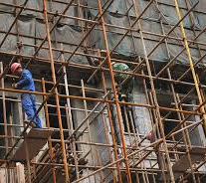
CLASSROOM PRACTICE :
SCAFFOLD AS NEEDED

Slide 27
CLASSROOM PRACTICE
Name
The
Standard

Slide 28
CLASSROOM PRACTICE
Use READING TERMS:
Central Idea
Supporting Details
Inference
Context Clues
“Sources”

Slide 29
CLASSROOM PRACTICE
But It’s OK to use:
“Bright Beginnings”
“Hook,”
“Clincher”
“Connecting Words”

Slide 30
CLASSROOM PRACTICE
Strategy:
Use
Mini-lessons,
“Focus Lessons”

Slide 31
CLASSROOM PRACTICE
Teach mini-lessons
as needed:
Look back in Text
“Supporting Details,”
“Paraphrase”
for Research

Slide 32
CLASSROOM PRACTICE
Learning Development is:
Connect with child’s life
Details for “Probably
True”
Frequent Varied Writing

Slide 33
CLASSROOM PRACTICE
MCAS 2.0 Prep is
Learning Development

Slide 34
CLASSROOM PRACTICE
MCAS 2.0 Prep
is
Teaching for Understanding, Skills

Slide 35
CLASSROOM PRACTICE
MCAS 2.0 Prep
is
Practice Tests
for Test Familiarity

Slide 36
CLASSROOM PRACTICE
MCAS 2.0 Prep
is Practice Tests,
To Assess,
Re-Teach in New Way

Slide 37
CLASSROOM PRACTICE
Smother students
with Reading
Opportunities

Slide 38
CLASSROOM PRACTICE
Reading Independently
Develops
Comprehension,
Vocabulary,
Fluency

Slide 39


Slide 40

CLASSROOM PRACTICE

Slide 41

MORE READING VIA TECHNOLOGY

Slide 42

CLASSROOM PRACTICE
Independent Reading
Creates
Strong
Readers

Slide 43
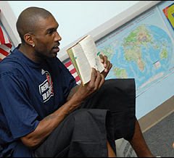
CLASSROOM
PRACTICE

Slide 44

CLASSROOM PRACTICE

Slide 45
Develop Strong Writing through
Varied and Frequent writing for varied purposes, and
Use the Writing Process of Drafting, Peer Edit, and Revision

Slide 46
CLASSROOM PRACTICE
Use Writing Process:
Drafting,
Peer Edit,
Conferencing,
Revision,
Final Edit

Slide 47

CLASSROOM PRACTICE WRITING TOGETHER

Slide 48
CLASSROOM
PRACTICE
Peer Editing
Provides student
Metacognition
Learning about
Learning

Slide 49

COLLABORATE ON WRITING

Slide 50
CLASSROOM PRACTICE
Peer Editing:
How to:
Structure Peer Editing
Calculated Partners
Baby Steps Practice

Slide 51
CLASSROOM PRACTICE
Peer Editing Benefits:
win-win-win
Each Writer gets
Instant Feedback
Peer Editor learn skills
Teacher Burden Lifted

Slide 52
CLASSROOM PRACTICE
Peer Editing:
Scaffold peer editing
Start small
A Bank of Comments
or Two Comments

Slide 53
CLASSROOM PRACTICE
Peer Editing:
Students Learn
When they are
Actively Engaged

Slide 54
CLASSROOM PRACTICE
Peer Editing:
Teacher Individual
Conferencing helps,
Students benefit as
reviewers too!

Slide 55
WRITING
FINAL
PRODUCT

Slide 56
NEW TEST QUESTION TYPE
TEXT-BASED
ESSAY

Slide 57
Test Features
“Write an Essay . .”
Means grade level
Standard Facets

Slide 58
ALERT ! Big Change:
“Text-Based Essay”
OpinionEssay, Narra-tive
Use the Text for material for the writing
Extend Narrative
using
passage
elements

Slide 59
TEST SAMPLE ITEMS
“TEXT BASED ESSAY”
SAMPLE QUESTIONS

Slide 60
This question is a text-based essay question. Write your essay in the space provided. Your essay should:
Present and develop a narrative that uses details from the passage.
Include correct grammar, spelling, punctuation
At the end of the passage, Howie tells Kevin that he is not making a good case. Write an original story that describes what Kevin does next to try to change Howie’s mind about paying for Cromwell’s training.

Slide 61
This question is a text-based essay question. Write your essay in the space provided. Your essay should:
Present and develop a central idea.
Provide evidence/details from the passage(s).
Include correct grammar, spelling, and punctuation.
Write an essay that explains how the article and the poem portray the blizzards of 1888. Be sure to use information from the article and the poem to develop your essay.

Slide 62
This question is a text-based essay question. Write your essay in the space provided. Your essay should:
Present and develop a central idea.
Provide evidence/details from the passage(s).
Include correct grammar, spelling, punctuation.
Based on the passage, write an essay to explain how Alex changed as he spent more time with Irene. Be sure to use information from the passage to develop your essay.

Slide 63
Argument and Essay Facets
Introduction
Reasons support introduction
t
Linking words and phrases
Word choice
Conclusion

Slide 64
NARRATIVE
WRITING
FACETS
Establish story
Use story dialogue, description
Transitional words
Concrete words
Conclusion follows events

Slide 65
Great Standards
Teaching
Results in Great
Learning

Slide 66
CLASSROOM PRACTICE
Big
Question
How to adapt a “Program”
for Standards Learning?

Slide 67
CLASSROOM PRACTICE
Big Questions:
How to teach for challenging reading passages?

Slide 68
TEST DATES
ELA MCAS
April 2 – May 4
Math and Science
April 3 –May 25

Slide 69
COMPUTER
TESTING
Computer testing
grades
4, 5, 7, 8
MUST
Use the practice test

Slide 70
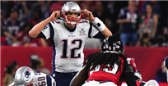
PRACTICE MAKES PERFECT

Slide 71
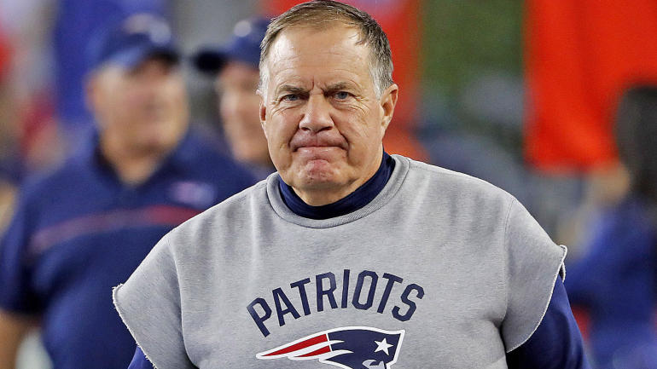
PRACTICE MAKES PERFECT

Slide 72

Teacher as Coach

Slide 73
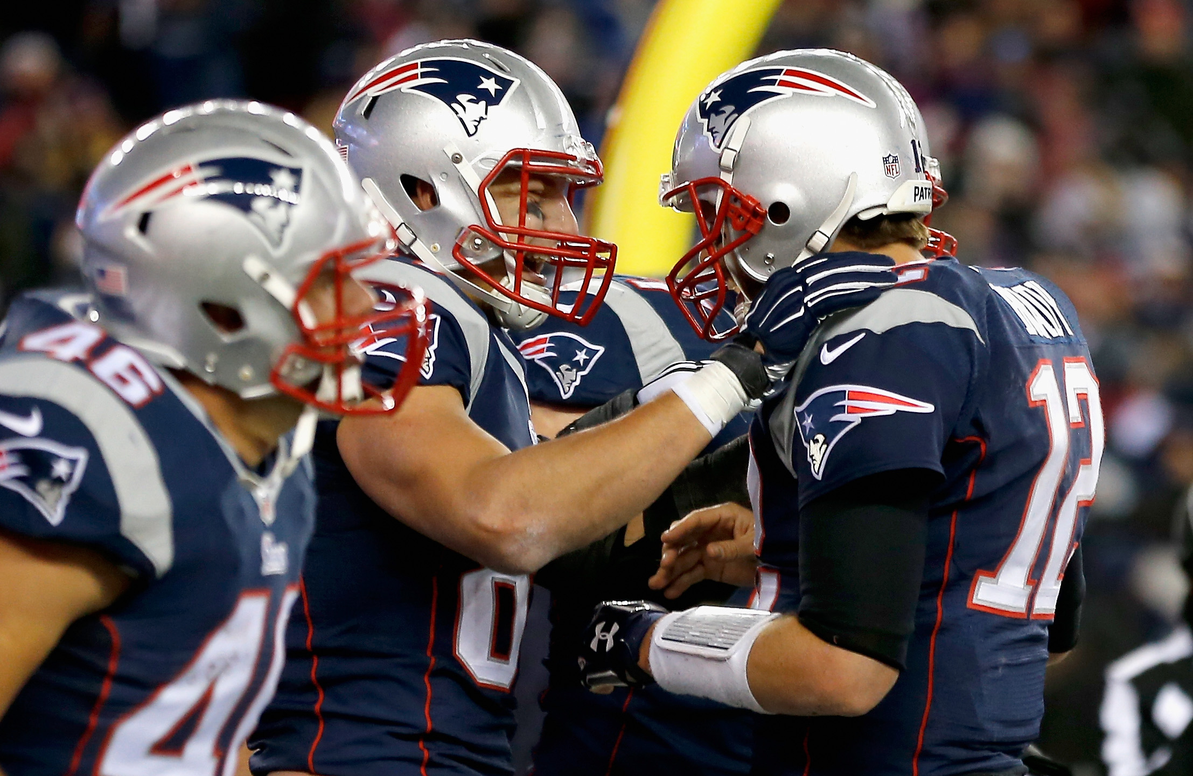
WINNERS

Slide 74


