Slide 1

WHAT IS
ELA MCAS
2020?

Slide 2

Shedding
Some
Light on
MCAS

Slide 3
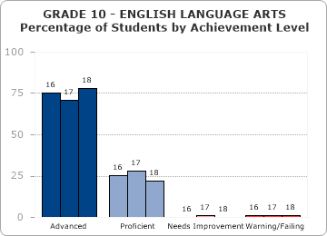
Weston 2018 78% Advanced

Slide 4
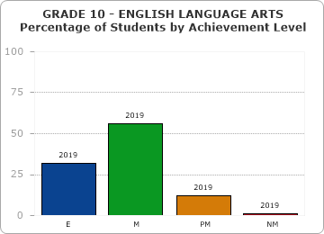
Weston 2018 78% Adv, 2019 32% Adv

Slide 5
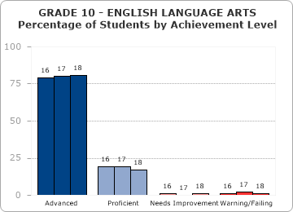
Lexington, 2018 81% Advanced

Slide 6
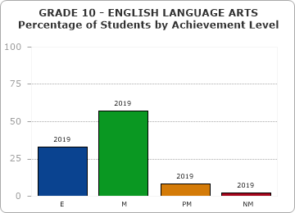
Lexington 2018 81% Adv, 2019 33% Adv

Slide 7
MCAS
ASSESSES
STANDARDS LEARNING

Slide 8
However,
Not all Standards are tested

Slide 9
Main tested Standards are:
#1. Close reading & inference
#2. Central idea & Text Evidence
#4. Context Clues for Vocabulary
#6 Speaker/narrator/ Point of View
The 3 writing types:
Opinion, Essay, Narrative
2

Slide 10
Know your grade level version of the tested Reading and the Writing Standards, posted at
http://www.corestandards.org/ELA-Literacy/
The Writing Facets are important

Slide 11
Test Features
MCAS 2020
Test
Features

Slide 12
Test Features
MCAS 2020
is about
Text EVIDENCE

Slide 13

Test Features
Where’s the
EVIDENCE
For reading and
writing questions

Slide 14
Test Features
MCAS 2020 Reading
is Part A (old MCAS)
New Part B:
Text Evidence

Slide 15
Test Features
Where is it stated??
Select the BEST
Example from
Part B to support A

Slide 16
Hard part is to locate the Part B sentence evidence on the computer.
So: Drill this skill

Slide 17
Test Feature Part A, Part B test question:
Students practice on computer lining up the sentences of evidence with the question asked
Scroll through reading passage to find the text evidence (using scroll bar), and align this with the test question, for text evidence
Teacher locates good test practice activity for which this Part B evidence applies, students do “scavenger hunt” activity to find text evidence

Slide 18
The ideal:
Integrate Standards Learning and Test Question Types into the full school year, for students to internalize learning

Slide 19
GRADE 3 test question on close reading/ inference with Part B text evidence
Part A Based on the passage, what will Willy and Roy most likely do the next evening?
A find the skateboard and go for a ride
B race to see who can move faster
C watch skateboarders in the park
D search for wheels that they lost
Part B
Which paragraph from the passage gives the best evidence for the answer to Part A?
A paragraph 4
B paragraph 14
C paragraph 20
D paragraph 32

Slide 20
Test Features
MCAS tests
Finer Reading
Ability

Slide 21
Test Tips: Reading Questions
Read the passage through for general comprehension; Look at the questions
GO BACK to the reading passage to locate answer
Some say first read the questions, then the passage It’s harder to comprehend the question if one doesn’t first get the gist of the reading passage (it’s an untimed test)

Slide 22
Test Features
As with “old” MCAS, MCAS 2020:
“Compare two readings”
A poem on every test

Slide 23
Test Features
MCAS 2020:
More Complex,
Challenging Reading 50% non-fiction, 75% non-fiction at gr 10

Slide 24
Test Tips for challenging reading passages 1.
Teach how to “read” the visual
Read ALL information before the passage: Title, Introductory, Use focus lessons to teach this!

Slide 25
Reading Challenging Text (continued) 2.
Read through till one sees sentences that start to make sense.
Be alert to this and use that comprehended area to guide the rest of the reading

Slide 26
Test Tips for Challenging reading passages 3.
Don’t have to fully comprehend passage:
The student only needs to try to answer test questions correctly (or best guess)
Let students know they don’t have to fully comprehend the passage
Practice this skill with practice test.
Just answer the questions correctly

Slide 27
CLASSROOM PRACTICE
Strategy:
Use Mini-lessons,
“Focus Lessons” to focus on areas of need

Slide 28
CLASSROOM PRACTICE
Read for Central Idea:
Make a case for Central Idea & Supporting Details

Slide 29
Classroom practice, Test Prep
Differentiate with Central Idea & Supporting Evidence skill:
Give varied levels of reading difficulty to different groups of students to practice in pairs, or small groups, or 3 groups,
with varied levels of reading difficulty to practice the skill of discerning central idea and “scavenger hunt” for supporting evidence (may also use mixed achievement level groups)
Use MCAS practice tests for this focus lesson on this skill
Use this same focus learning process for the skills of inference, context clues, speaker/ narrator point of view

Slide 30
Classroom practice, Test Prep
Differentiate with Central Idea & Supporting Evidence:
Use MCAS practice tests for this focus lessons on this skill
Use focus learning process for the skills of inference, context clues, speaker/ narrator, point of view

Slide 31
In classroom practice
NAME the Standard:
“Close Reading,”
“Inference”
“Context Clues for Vocabulary”

Slide 32
Classroom practice, test prep
When we name the Standard or skill, students may begin to recognize the Standard and see that it’s familiar and they’ve been taught this.

Slide 33
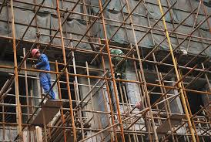
CLASSROOM PRACTICE
SCAFFOLD AS NEEDED

Slide 34
CLASSROOM PRACTICE Test Prep
Use both:
1.Scaffold (use supports) to teach the skill
2.And use released tests

Slide 35
CLASSROOM PRACTICE
To teach
Inference:
“CLUES” for “Probably True”

Slide 36
Test Features
MCAS 2020
Varied Types of Writing

Slide 37
TEST QUESTION TYPE
TEXT-BASED ESSAY

Slide 38
Test Features
“Write an Essay . .”
Means use
grade level
“Essay” Standard Facets

Slide 39
“Text-Based Essay” replaces old MCAS “Open Response” writing,
It’s Opinion, Essay, Narrative
Use the Reading Passage for
material for writing

Slide 40
Narrative Writing:
First develop a plot
Then Extend the Narrative
using passage elements
Must include dialogue, transitions, character, point of view, plot

Slide 41
Text-based writing
READ the Question CLOSELY
What is question asking for?
Look at the passage for text evidence
Select points related to question Draft, or Rough outline, or use Graphic organizer. Then Write.

Slide 42
Text-based writing
Revise and edit
READERS ARE NOW LOOKING MORE CLOSELY AT THE CONVENTIONS OF CORRECT SPELLING, PUNCTUATION, SENTENCING
Still, more points for idea development

Slide 43
Examples of Text-Based Writing question
This same question format is used at each grade level
Familiarize students with this question format!

Slide 44
This question is a text-based essay question. Write your essay in the space provided. Your essay should:
Present and develop a narrative that uses details from the passage.
Include correct grammar, spelling, punctuation
At the end of the passage, Howie tells Kevin that he is not making a good case. Write an original story that describes what Kevin does next to try to change Howie’s mind about paying for Cromwell’s training.

Slide 45
This question is a text-based essay question. Write your essay in space provided. Your essay should:
Present and develop a central idea.
Provide evidence/details from the passage(s).
Include correct grammar, spelling, and punctuation.
Write an essay that explains how the article and the poem portray the blizzards of 1888. Be sure to use information from the article and the poem to develop your essay.

Slide 46
This question is a text-based essay question. Write your essay in the space provided. Your essay should:
Present and develop a central idea.
Provide evidence/details from the passage(s).
Include correct grammar, spelling, punctuation.
Based on the passage, write an essay to explain how Alex changed as he spent more time with Irene. Be sure to use information from the passage to develop your essay.

Slide 47
Transitional words or phrases” is a Standards Facet
Transitions show
The writer understands the connection between paragraphs and sentences
Helps the reader see the connection between paragraphs and sentences.
Therefore, Provide examples of transitional words or phrases: “Next,” “Finally,” Then give examples of text with transitions, then have students circle the transitional words or phrases, also have them think of appropriate alternative transitions.

Slide 48
CLASSROOM PRACTICE
MCAS Prep
is
Learning Development

Slide 49
CLASSROOM PRACTICE
MCAS Prep
is
Teaching for Understanding,
Skills
OVERTEACH for retention

Slide 50
CLASSROOM PRACTICE
MCAS Prep
Is Use
Practice Tests
for Test Familiarity

Slide 51
Classroom Practice, Test Prep
“Teaching for the Test”
is a Good Thing!
Teaches needed reading and writing skills
Assesses where students are in reading and writing

Slide 52
Practice Tests site
2019 practice tests:
http://mcas.pearsonsupport.
com/student/practicetest.ela/

Slide 53
Released Tests site
2017 - 2019 computer released practice tests:
http://mcas.pearsonsupport.
com/releaseditems.ela/

Slide 54
CLASSROOM PRACTICE Test Prep
MCAS Prep is
Use the Practice Tests, to
Assess, Discuss best answers
Re-Teach in New Way

Slide 55
Teach for the Test
Work on these Tested areas: They’re needed skills: Comprehend complex text, Text-based writing is reading comprehension and writing, Use context clues for vocabulary, are all ESSENTIAL skills. Best to use MCAS released passages

Slide 56
CLASSROOM PRACTICE
Long term:
Smother students
with Reading
Opportunities

Slide 57


Slide 58


Slide 59
CLASSROOM PRACTICE
Reading Independently
Develops
Comprehension,
Vocabulary, Fluency

Slide 60

CLASSROOM PRACTICE: classroom libraries are books to books to self-select, take home

Slide 61
Create
Classroom Libraries of low-cost good books, buy “used” from Amazon, cheap!
,

Slide 62

MORE READING VIA
TECHNOLOGY

Slide 63

Long-Term CLASSROOM PRACTICE
Independent Reading
Creates
Strong
Readers

Slide 64
Write about the reading
Free-writing, journal writing, write a letter to recommend (or not), write about what you liked in the book (or didn’t) all develops writing fluency

Slide 65
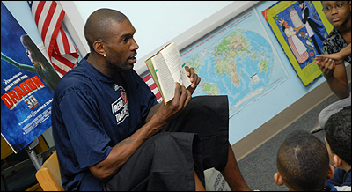
CLASSROOM PRACTICE: reading aloud to students at any age develops reading ability, helps students make sense of the reading

Slide 66
Great Standards Teaching
Results in Great Learning
Canton, MA score increase with focus lessons on close reading. ELA scores moved from 62% Proficient to 91%, Needs Improvement dropped from 18% to 8%, 1% Warning
.

Slide 67
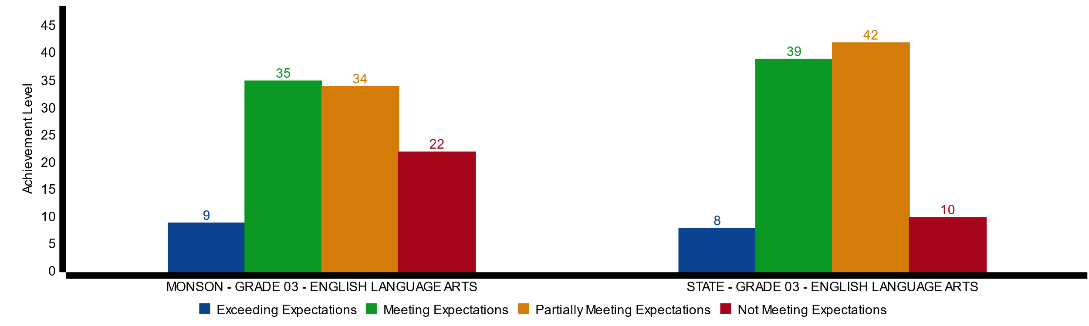
Monson, gr 3 2017:
22% not meeting expectations

Slide 68
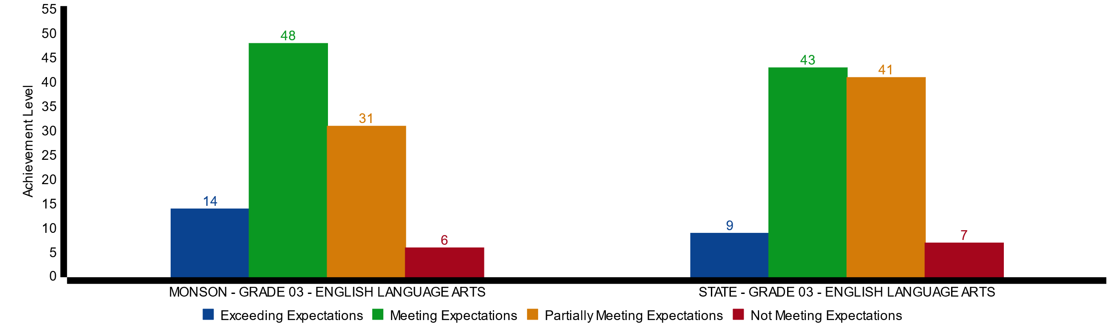
Monson, gr. 3, 2018:
6% Not meeting expectations

Slide 69


