Slide 1
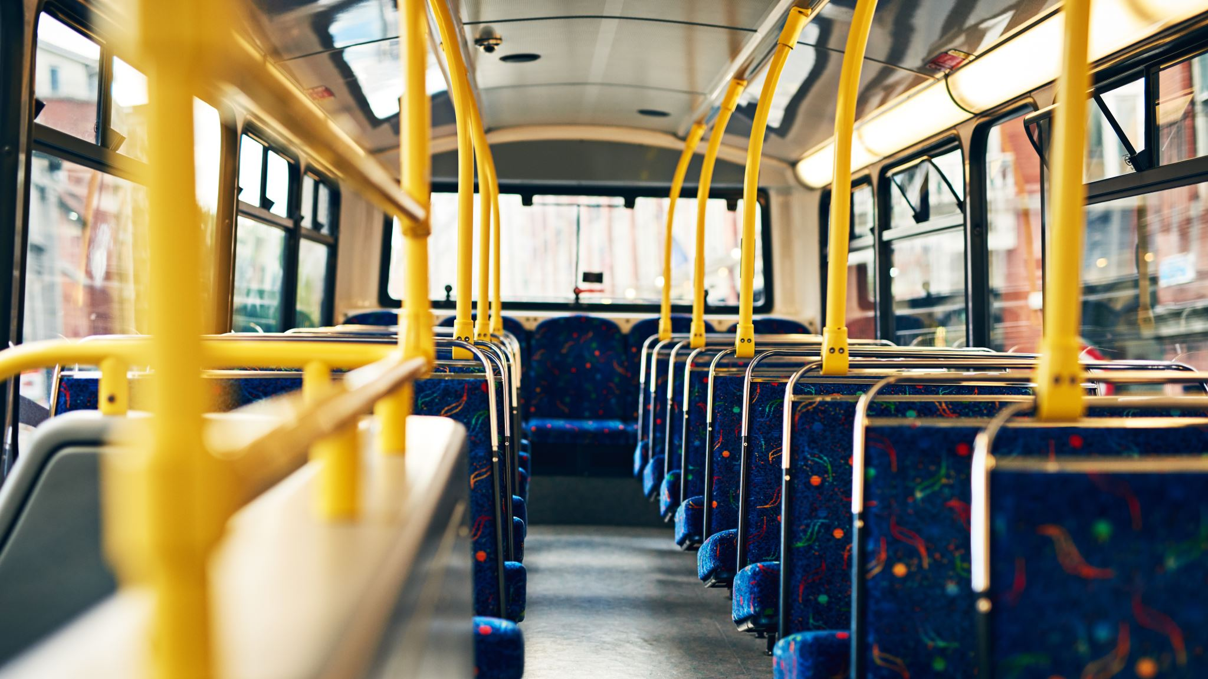
WEBSTER PUBLIC SCHOOLS Sept 4, 2020 REACHING OUT REMOTELY

Slide 2
REMOTE AND HYBRID LEARNING

Slide 3
Bridging the Gap to Remote Learning

Slide 4
Kay Scheidler
kayscheidler@hotmail.com
www.kayscheidler.com

Slide 5
Moving from Knowing your students and not in class to Not knowing your students and not in class

Slide 6
*Get to know your students,
who they are,
what they can do
-- While developing your subject’s learning,
Right from the start!

Slide 7
Fall Back-to-School time is the Best Learning time
Research tells us spring and summer learning loss
is minimal

Slide 8
REACHING OUT REMOTELY: PLANNING, STRATEGIES, RESOURCES

Slide 9
Who is Kay? Who is Kay?: Teacher, Curriculum Director: Monson, Southbridge, Everett, Marblehead, Hamilton-Wenham Assistant Supt. For Curriculum: Hopkinton, Canton Currently: French River Education Center, Framingham State University, Salem Collaborative

Slide 10
Remote Learning is Fun!
I’ve been creating and implementing distance-learning courses as teacher graduate courses for twelve years, and I LOVE Remote Learning!

Slide 11
REMOTE LEARNING IS: Teach what you normally teach . . . . with some modifications See What can work, what doesn’t

Slide 12
VALUES GUIDE THE WORK
What mainly are our values that drive our work in today’s most challenging times?

Slide 13
Value: Dedicated to work with students In the best way possible

Slide 14
1. Advantages of Remote Learning 2. Use the tools you have, add on 3. Build a unit, add others: Create Learning 4. Engage all students

Slide 15
Not every child’s life . . .

Slide 16
Challenges with Remote Learning: *Tools are new to many teachers * We rely on home support * Home distractions for many students * Lack of good remote tech support * Requires self-discipline on students’ part

Slide 17
Advantages of Remote Learning: *Easier to plan for, Stick to the Plan *Distractions can be eliminated *Personalize with Chats *Many students enjoy tech skills, online. They can help teachers with this.

Slide 18
REMOTE LEARNING
Remote Learning
Can Be
Great Learning!

Slide 19
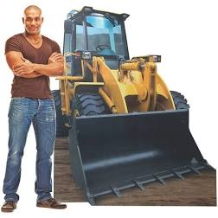
FRONTLOADING LEARNING

Slide 20
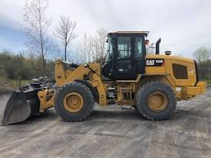
Teaching and Learning works best when we Frontload up front

Slide 21
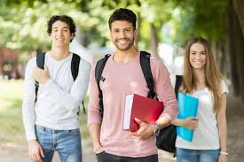
First Planning Well ENDS WELL! E

Slide 23
I. Remote Learning: Learning
Plan a unit:
Sketch out a unit on paper
State the learning goals
Then activities for learning

Slide 24
I. Remote Learning: Learning
Example:
Learning goal:
Students will learn to write an
essay using the Common Core
Standards five facets

Slide 25
I. Remote Learning: Learning
Essay writing:
Preassess: What can the student(s) do now?
What do they need to know?
Stepping stones:
Provide rubric guide for Essay
Build skills in key needed areas: Introduction, Text evidence, Transitional words, striking language, conventions, conclusion
Develop peer edit skills (start small and focused, build to longer, better), use PowerPoints, show exemplary writing, take weak writing and improve, do “shades of meaning” activities, teacher conferencing on areas needed, revise, revise
Assess, and re-teach as needed

Slide 26
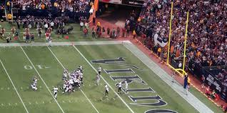
I. Remote Learning: Learning
The Learning Goal is what’s essential to learn,
not just nice to know, tangential, fun to learn

Slide 27
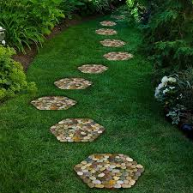
I. Remote Learning: Learning
The Stepping Stones to learning aren’t just activities, fun to do
They’re the
Learning Activities to develop that learning

Slide 28
Tips for Learning New Tools
Video tutorials abound, including YouTube videos. Google a question. In asking for help, state specifically what you need, Start with just the basics and move up from there. Flipgrid tutorial:
https://www.youtube.com/watch?v=vJOoloQ7k5Q

Slide 29
Learning Activity Tip
Teachers find it easier to break students into small groups and monitor group discussions in Zoom, rather than with Google Meet.
Video tutorials on creating breakout groups in Zoom and Meet abound.

Slide 30
Recommendation: To Establish Learning as a Goal
Sept 15
Getting to know you day
Create a fully remote learning plan for these first 4 days to establish learning as a goal
Self-Assess this work, Poll students.
Sept 16- 21
Introduce and implement a 5- or 6-day fully remote unit with clear Learning Goals, Stepping Stones learning activities, Assessment

Slide 31
Recommendation: In hybrid learning:
As you go, you’ll see which strategies work better for Remote or in-class:
Are you and your students best at class discussion mode for Remote, in Google Meet or Zoom, or does this work better these different days in in-class work?
Is it best to present in Remote or in-class mode?

Slide 32
Stop and Reflect:
What are my values with school re-opening?
What are Learning Goals I most need to work on?
How can I get better with Remote Learning?

Slide 33
ENGAGING ALL STUDENTS

Slide 34
Remote Learning
Requires
Reaching out
Empathy
Engagement

Slide 35
ENGAGING ALL STUDENTS
With Remote Learning, it’s necessary to engage all students, in varied ways, as much as possible.
When we can provide good structure and good reaching out from the beginning, we’re more likely to retain students, help them all learn.

Slide 36
ENGAGING ALL STUDENTS
* Strict due dates (and be flexible)
Short timelines: Not, “Finish this when you can.”
Work is graded (and allow re-doing)

Slide 37
ENGAGING ALL STUDENTS
But Don’t fail a student early on
Use Google Meet, Zoom sessions for
students to connect with peers

Slide 38
* Email, chat, call home as needed for struggling students * Use small groups, exit tickets * Google form mental health check-in * “40 Weird Questions” site as Engagement Strategies, No wrong answer, brief games for engagement

Slide 39
HOW ARE YOU FEELING TODAY Google Form

Slide 40
Stop and Reflect:
What can I do on day one to engage all students?
What structures can I put in place to support good continued engagement?
What can I do to prevent losing students?
What can I do if I begin to lose students?

Slide 41
LEARNING AND ENGAGEMENT
EXAMPLE OF A LEARNING PROJECT WHERE:
STUDENTS LEARN
ENGAGES STUDENTS
IS REMOTE

Slide 42
WEBQUEST
OR QUEST
“My eighth graders
would be turned off if I
called it webquest
but love it if I call it a
‘Quest’.”

Slide 43
LEARNING and ENGAGEMENT and REMOTE and Hybrid ANY SUBJECT and ANY STUDENT
WEB QUEST:
PICK A TOPIC KEY TO YOUR SUBJECT
INSTEAD OF EXPLAINING THE TOPIC, STUDENTS RESEARCH IT
THE TEACHER CAPTURES WEB SITES ON THE TOPIC that are
A RANGE AND STUDENT-APPROPRIATE (GOLDILOCKS)
THINK OF ONE QUESTION TO EXPLORE
STUDENT FINAL REPORT IS: WRITING, A BROCHURE, or
GOOGLE SLIDES PRESENTATION
STUDENTS VERBALLY REPORT OUT (as in a SCIENCE FAIR)

Slide 44
In Webquests, students develop:
Your subject knowledge
Research skills, needed for college, the workplace, life
How to document sources, avoid plagiarism
Learn how to learn
Follow their passion, to find a topic of their interest
Presentation skills
Teamwork

Slide 45
In Webquest work, the teacher is a coach

Slide 46
Webquests
Guide for Webquest success:
Start small, with one short 2-day project with lots of coaching
Gradually move in small steps to bigger projects with more sites to explore
Show how to document sites
Place the sites in order of difficulty, easy to more complex, challenging

Slide 47
Webquests
Guide for Webquest success:
Students may self-select sites, or teacher guides
The more time spent on developing the webquest, the better it works
Websites can be re-used, in different classes, different years
Webquest work can be done remotely!

Slide 48
Stop and Reflect:
What’s a topic I can focus on for a webquest?
What’s topic that’s important for my subject and of interest to students?
How and when can I start a webquest project in a way appropriate for my students?

Slide 49
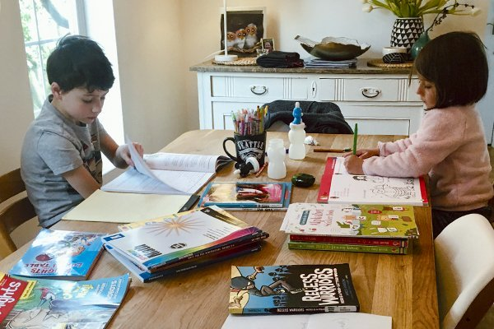
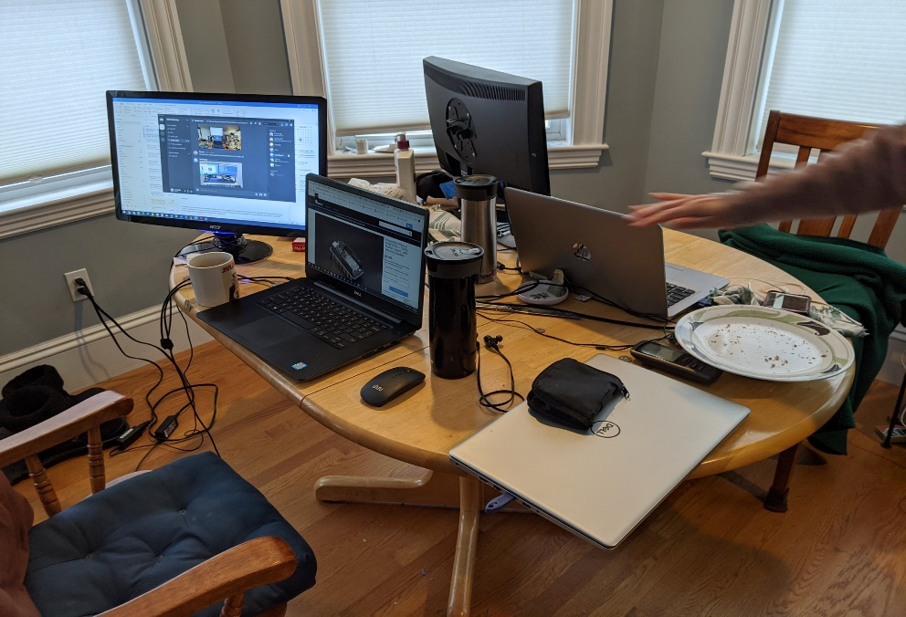
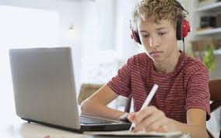
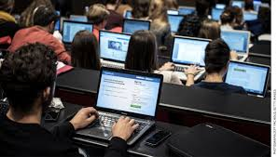

Slide 50
Resources
www.kayscheidler.com Left side top: Resources for Remote Learning
Sample of fully remote learning plans
List of additional electronic tools that teachers are commonly using
Articles on remote learning that also include how tools are used
Webquest examples, Art sites

